Slide 1

03-Linked List

Slide 2

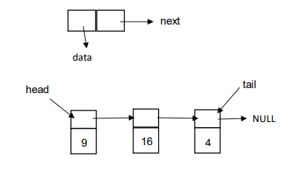
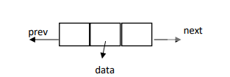
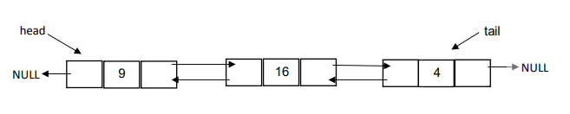
רשימה מקושרת היא מבנה נתונים שבו העצמים ערכיים (איברים) מסודרים בסדר ליניארי.
בניגוד למערך שבו הסדר הליניארי נקבע על ידי אינדקסים, ברשימה מקושרת הסדר נקבע על ידי מצביעים הכוללים בכל אחד מן העצמים.
כל איברים (עצמים) ברשימה מקושרת נמצאים בזיכרון באופן אקראי.
סוגים של רשימה מקושרת:
רשימה מקושרת חד-כיוונית
רשימה מקושרת דו-כיוונית
רשימה מקושרת מעגלית
גם רשימה מקושרת חד-כיוונית וגם רשימה מקושרת דו-כיוונית יכולות להיות מעגליות (איבר הארון מצביע לאיבר הראשון ברשימה מקושרת).

Slide 3
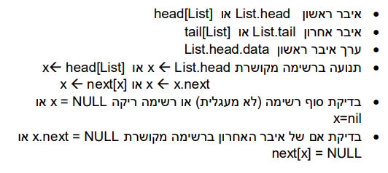

גישה לאיברי רשימה מקושרת (נניח ששם של רשימה List)

Slide 4
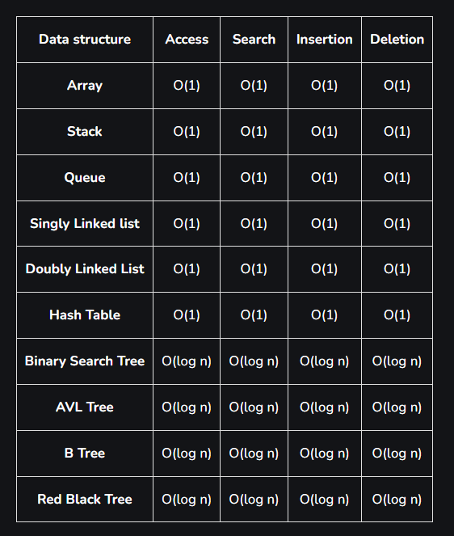
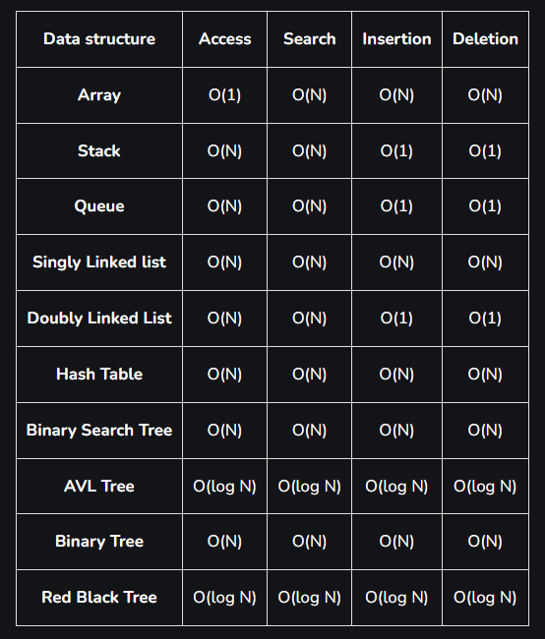
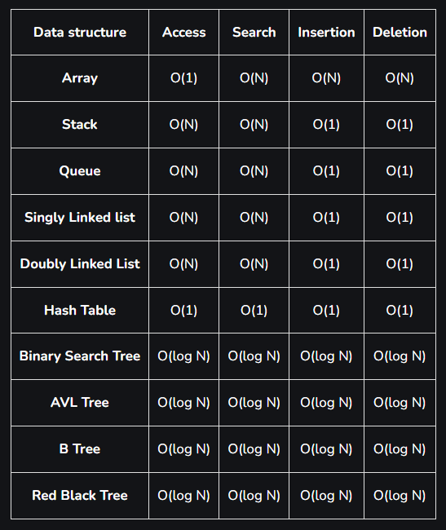
Time complexities of different data structures
Best case time complexity of different data structures for different operations
Worst Case time complexity of different data structures for different operations
The average time complexity of different data structures for different operations

Slide 5
תרגיל 1
כתבו פסאודו-קוד של אלגוריתם המקבל רשימה מקושרת חד-כיוונית ומחזיר סכום מספרים זוגיים.
function sumOfEvenNumbers(linkedList):
if linkedList is empty:
return 0 # Empty list, sum of even numbers is 0
sum = 0
node = linkedList.head # Start from the head of the list
while node is not null:
if node.value is even:
sum = sum + node.value # Add the even number to the sum
node = node.next # Move to the next node in the list
return sum
Notes:
The time complexity of the algorithm `sumOfEvenNumbers` for a linked list is O(N), where N is the number of nodes in the linked list.
1. **Initialization:**
- The function initializes the `sum` variable to 0 and sets the `node` pointer to the head of the linked list. Both of these operations take constant time, O(1).
2. **Traversing the List:**
- The algorithm uses a `while` loop to iterate through each node in the linked list. In the worst case, it visits each node exactly once, making this part of the algorithm O(N), where N is the number of nodes in the linked list.
3. **Checking and Summing:**
- Within the loop, there is a constant-time operation to check if the value of the current node is even and then add it to the `sum` variable if it is. These operations do not depend on the size of the linked list and are O(1).
4. **Moving to the Next Node:**
- After each iteration, the `node` pointer is moved to the next node in the list. This is a constant-time operation, O(1).
5. **Returning the Result:**
- Finally, the function returns the calculated sum. This is a constant-time operation, O(1).
Therefore, the dominant factor contributing to the time complexity is the traversal of the linked list, which results in an overall time complexity of O(N), where N is the number of nodes in the linked list.

Slide 6
תרגיל 2
כתבו פסאודו-קוד של אלגוריתם תחליף בין איבר ראשון ואחרון ברשימה מקושרת חד-כיוונית.
function swapFirstAndLast(linkedList):
## swap values - bad solution
if linkedList is empty or has only one node:
return linkedList # Nothing to swap
firstNode = linkedList.head
lastNode = linkedList.head
# Traverse the list to find the last node
while lastNode.next is not null:
lastNode = lastNode.next
# Swap values of the first and last nodes
temp = firstNode.value
firstNode.value = lastNode.value
lastNode.value = temp
return linkedList
function swapFirstAndLast(linkedList):
if linkedList.head is NULL or linkedList.head.next is NULL: return linkedList
firstNode = linkedList.head
prevToLast = NULL
lastNode = linkedList.head
while lastNode.next is not NULL:
prevToLast = lastNode
lastNode = lastNode.next
if prevToLast is not NULL:
prevToLast.next = firstNode
lastNode.next = firstNode.next
firstNode.next = NULL
linkedList.head = lastNode
return linkedList
Notes:
The time complexity of the `swapFirstAndLast` algorithm for a linked list is O(N), where N is the number of nodes in the linked list.
1. **Base Case Check:**
- The function checks if the linked list is empty or has only one node. This is a constant-time operation, O(1).
2. **Finding the Last Node:**
- The algorithm uses a `while` loop to traverse the linked list and find the last node. In the worst case, it visits each node once, making this part of the algorithm O(N), where N is the number of nodes in the linked list.
3. **Swapping Values:**
- After finding the last node, the algorithm swaps the values of the first and last nodes. This is a constant-time operation, O(1).
4. **Returning the Result:**
- Finally, the function returns the modified linked list. This is a constant-time operation, O(1).
The dominant factor contributing to the time complexity is the traversal of the linked list, resulting in an overall time complexity of O(N), where N is the number of nodes in the linked list.

Slide 7
תרגיל 3
כתבו פסאודו-קוד של אלגוריתם שמוסיף צומת חדש לרשימה מקושרת ממוינת תוך שמירה על הסדר הממויין של הרשימה.
function try(L, N):
# L is a sorted Linked List
# N is a Linked List with one node
if L.head is NULL:
L.head ← N.head
else:
if N.head.data < L.head.data:
N.head.next ← L.head
L.head ← N.head
else:
x ← L.head
while x.next is not NULL and N.head.data ≥ x.next.data:
x ← x.next
N.head.next ← x.next
x.next ← N.head
return L
This algorithm should properly merge a sorted linked list L with a linked list N that has only one node.
Notes:
The time complexity of the `try` algorithm depends on the size of the sorted linked list `L` and the position where the node from `N` is inserted into `L`. Let's analyze each part:
1. **Base Case Check:**
- Checking if `L.head` is NULL is a constant-time operation, O(1).
2. **Insertion at the Beginning of `L`:**
- If `L.head` is NULL, the algorithm inserts the node from `N` at the beginning of `L`. This is a constant-time operation, O(1).
3. **Insertion at a Position Other Than the Beginning:**
- If `L.head` is not NULL, the algorithm checks whether the node from `N` should be inserted before the current head of `L` based on the comparison of data values.
- If insertion is at the beginning, it is a constant-time operation, O(1).
- Otherwise, the algorithm uses a `while` loop to traverse `L` to find the correct position for insertion. In the worst case, it may need to traverse the entire list, resulting in a time complexity of O(N), where N is the number of nodes in `L`.
Overall, the time complexity of the `try` algorithm is O(N) in the worst case, where N is the number of nodes in the sorted linked list `L`. If the insertion happens at the beginning (when `L.head` is NULL) or is at a position other than the beginning, it is O(1).

Slide 8
תרגיל 4
כתבן פסאודו-קוד של אלגוריתם הממיין רשימה מקושרת חד-כיוונית.
function sortLinkedList(linkedList):
if linkedList.head is NULL or linkedList.head.next is NULL: return linkedList
middle = getMiddle(linkedList.head)
secondHalf = middle.next middle.next = NULL
left = sortLinkedList(linkedList)
right = sortLinkedList(secondHalf)
return merge(left, right)
function getMiddle(head):
slow = head
fast = head
while fast.next is not NULL and fast.next.next is not NULL:
slow = slow.next
fast = fast.next.next
return slow
Notes:
The time complexity of the Bubble Sort algorithm applied to a linked list is O(N^2), where N is the number of nodes in the linked list. Here's the breakdown of the time complexity:
Outer Loop (Traversing the List):
The outer loop of the Bubble Sort algorithm iterates N times, where N is the number of nodes in the linked list. In each iteration, the algorithm compares and possibly swaps adjacent elements.
The worst-case scenario is when the list is in reverse order, and the algorithm needs to perform N iterations for each element to move it to its correct position.
Therefore, the time complexity of the outer loop is O(N).
Inner Loop (Comparisons and Swaps):
The inner loop compares and swaps adjacent elements. In the worst case, the inner loop iterates N times for each outer loop iteration.
The total number of comparisons and swaps in the inner loop is proportional to N^2.
Therefore, the time complexity of the inner loop is O(N^2).
Overall Time Complexity:
Combining the time complexities of the outer and inner loops, the overall time complexity of the Bubble Sort algorithm for a linked list is O(N) * O(N^2) = O(N^2).
Bubble Sort is not the most efficient sorting algorithm, especially for large datasets, but it is straightforward to implement. Other sorting algorithms like Merge Sort or Quick Sort may offer better performance for large datasets.
Merge Sort algorithm adapted for a linked list. Run time: O(n log n)
function mergeSortLinkedList(head):
if head is NULL or head.next is NULL:
return head // Base case: empty or single-node list
// Split the linked list into two halves
middle = findMiddle(head)
leftList = head
rightList = middle.next
middle.next = NULL // Splitting the list
// Recursively sort both halves
leftList = mergeSortLinkedList(leftList)
rightList = mergeSortLinkedList(rightList)
// Merge the sorted halves
sortedList = merge(leftList, rightList)
return sortedList
function findMiddle(head):
slowPointer = head
fastPointer = head.next
while fastPointer is not NULL and fastPointer.next is not NULL:
slowPointer = slowPointer.next
fastPointer = fastPointer.next.next
return slowPointer
function merge(left, right):
mergedList = NULL
tail = NULL
while left is not NULL and right is not NULL:
if left.data <= right.data:
if mergedList is NULL:
mergedList = tail = left
else:
tail.next = left
tail = left
left = left.next
else:
if mergedList is NULL:
mergedList = tail = right
else:
tail.next = right
tail = right
right = right.next
// Append remaining elements from both lists
if left is not NULL:
tail.next = left
else:
tail.next = right
return mergedList

Slide 9
תרגיל 4 המשך
כתבן פסאודו-קוד של אלגוריתם הממיין רשימה מקושרת חד-כיוונית.
function merge(left, right):
dummyNode = Node(0)
current = dummyNode
while left is not NULL and right is not NULL:
if left.value < right.value:
current.next = left
left = left.next
else:
current.next = right
right = right.next
current = current.next
if left is not NULL:
current.next = left
else:
current.next = right
return dummyNode.next
Notes:
The time complexity of the Bubble Sort algorithm applied to a linked list is O(N^2), where N is the number of nodes in the linked list. Here's the breakdown of the time complexity:
Outer Loop (Traversing the List):
The outer loop of the Bubble Sort algorithm iterates N times, where N is the number of nodes in the linked list. In each iteration, the algorithm compares and possibly swaps adjacent elements.
The worst-case scenario is when the list is in reverse order, and the algorithm needs to perform N iterations for each element to move it to its correct position.
Therefore, the time complexity of the outer loop is O(N).
Inner Loop (Comparisons and Swaps):
The inner loop compares and swaps adjacent elements. In the worst case, the inner loop iterates N times for each outer loop iteration.
The total number of comparisons and swaps in the inner loop is proportional to N^2.
Therefore, the time complexity of the inner loop is O(N^2).
Overall Time Complexity:
Combining the time complexities of the outer and inner loops, the overall time complexity of the Bubble Sort algorithm for a linked list is O(N) * O(N^2) = O(N^2).
Bubble Sort is not the most efficient sorting algorithm, especially for large datasets, but it is straightforward to implement. Other sorting algorithms like Merge Sort or Quick Sort may offer better performance for large datasets.
Merge Sort algorithm adapted for a linked list. Run time: O(n log n)
function mergeSortLinkedList(head):
if head is NULL or head.next is NULL:
return head // Base case: empty or single-node list
// Split the linked list into two halves
middle = findMiddle(head)
leftList = head
rightList = middle.next
middle.next = NULL // Splitting the list
// Recursively sort both halves
leftList = mergeSortLinkedList(leftList)
rightList = mergeSortLinkedList(rightList)
// Merge the sorted halves
sortedList = merge(leftList, rightList)
return sortedList
function findMiddle(head):
slowPointer = head
fastPointer = head.next
while fastPointer is not NULL and fastPointer.next is not NULL:
slowPointer = slowPointer.next
fastPointer = fastPointer.next.next
return slowPointer
function merge(left, right):
mergedList = NULL
tail = NULL
while left is not NULL and right is not NULL:
if left.data <= right.data:
if mergedList is NULL:
mergedList = tail = left
else:
tail.next = left
tail = left
left = left.next
else:
if mergedList is NULL:
mergedList = tail = right
else:
tail.next = right
tail = right
right = right.next
// Append remaining elements from both lists
if left is not NULL:
tail.next = left
else:
tail.next = right
return mergedList

Slide 10
תרגיל 5
כתבו פסאודו-קוד של אלגוריתם המקבל רשימה מקושרת חד-כיוונית מעגלית ומוסיף איבר נוסף ל"סוף" רשימה (לפני איבר שמצביע לראש רשימה).
function addAtEndCircularLinkedList(list, value):
// Create a new node
newNode = createNode(value)
// If the list is empty, make the new node the head of the list
if list.head is NULL:
list.head = newNode
newNode.next = newNode // Point to itself to form a circular list
else:
// Traverse the list to find the node before the head
current = list.head
while current.next is not list.head:
current = current.next
// Insert the new node at the end
current.next = newNode
newNode.next = list.head
Notes:
The time complexity of the addAtEndCircularLinkedList algorithm depends on the number of nodes in the circular linked list. Let's analyze the time complexity step by step:
Base Case Check:
The initial check for whether the list is empty is a constant-time operation, O(1).
Creating a New Node:
Creating a new node using createNode(value) is a constant-time operation, O(1).
Inserting at the End:
If the list is not empty, the algorithm traverses the circular list to find the node before the head.
In the worst case, the traversal requires visiting each node once. Therefore, the traversal has a time complexity of O(N), where N is the number of nodes in the circular linked list.
Inserting the New Node:
After finding the node before the head, the algorithm inserts the new node at the end. This is a constant-time operation, O(1).
The dominant factor in the time complexity is the traversal of the circular list, resulting in an overall time complexity of O(N), where N is the number of nodes in the circular linked list. If the list is empty, the time complexity is O(1).

Slide 11
תרגיל 6
function try(L):
// L is a bidirectional linked list
// Initialize variables
flag <- true
x.left <- x.right <- L.head
// Check if the list is not empty and has more than one element
if L.head ≠ NULL AND L.head.next ≠ NULL then
// Move x.right to the end of the list
while x.right.next ≠ NULL do
x.right <- x.right.next
// Check for palindromic property
while x.right ≠ x.left and x.left.next ≠ x.right and flag do
// Compare data of nodes from both ends
if x.right.data ≠ x.left.data then
flag <- false
// Move to the next nodes from both ends
x.left <- x.left.next
x.right <- x.right.prev
// Return the result
return flag
נתון אלגוריתם. איזה ערך הוא מחזיר?
Notes:
Time complexity of the ‘try’ algorithm:
Let's analyze the time complexity of the provided Palindrom algorithm:
Base Case Check:
The initial check to see if the list is not empty and has more than one element is a constant-time operation, O(1).
Finding the End of the List:
The algorithm uses a while loop to move x.right to the end of the list. In the worst case, this requires visiting each node once, resulting in a time complexity of O(N), where N is the number of nodes in the linked list.
Checking for Palindromic Property:
The second while loop checks for the palindromic property by comparing data values of nodes from both ends of the list.
In the worst case, the loop requires visiting each node once, resulting in a time complexity of O(N), where N is the number of nodes in the linked list.
Returning the Result:
Returning the final result (flag) is a constant-time operation, O(1).
The dominant factor contributing to the time complexity is the traversal of the linked list, both in finding the end of the list and checking for the palindromic property. Therefore, the overall time complexity of the Palindrom algorithm is O(N), where N is the number of nodes in the linked list.

Slide 12


